Slide 1
CHIPKO MOVEMENT
Presented by ,
Utkarsh Singh
17539

Slide 2
What is Chipko movement?
The Chipko movement or Chipko Andolan was a forest conservation movement where people Hug the trees to prevent them from being cut.
Chipko–type movements date back to 1730 AD when in Khejarli village of Rajasthan, 363 Bishnois sacrificed their lives to save khejri trees.
Notes:
How presentation will benefit audience: Adult learners are more interested in a subject if they know how or why it is important to them.
Presenter’s level of expertise in the subject: Briefly state your credentials in this area, or explain why participants should listen to you.

Slide 3
When and Where it Begins ?
It began in 1973 in Uttarakhand (then in Uttar Pradesh) and went on to become a rallying point for many future environmental movements all over the world.
Notes:
Example objectives
At the end of this lesson, you will be able to:
Save files to the team Web server.
Move files to different locations on the team Web server.
Share files on the team Web server.

Slide 4
Why it happened?
Government's decision to allot forest trees to Industrialists.
Mr. Chandi Prasad Bhatt of ‘Dasoli Gram Swarajya Sangh’(DGSS) wanted to establish small industries using forest resources, with an aim to provide job opportunities to local youth and check migration.

Slide 5
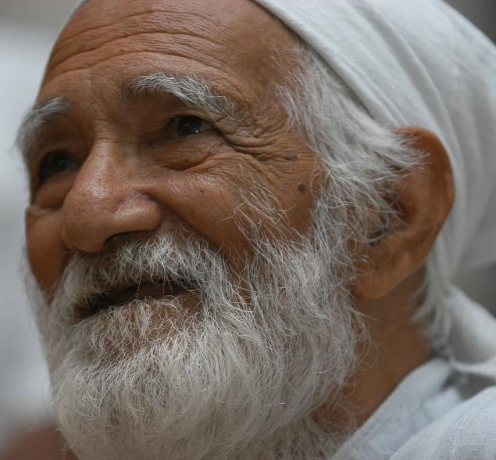
Sunder Lal Bahuguna
He is the Environmentalist , Gandhian.
Also known as DEFENDER OF HIMALAYA.
Padmabhushan winner for his contribution in the movement.

Slide 6
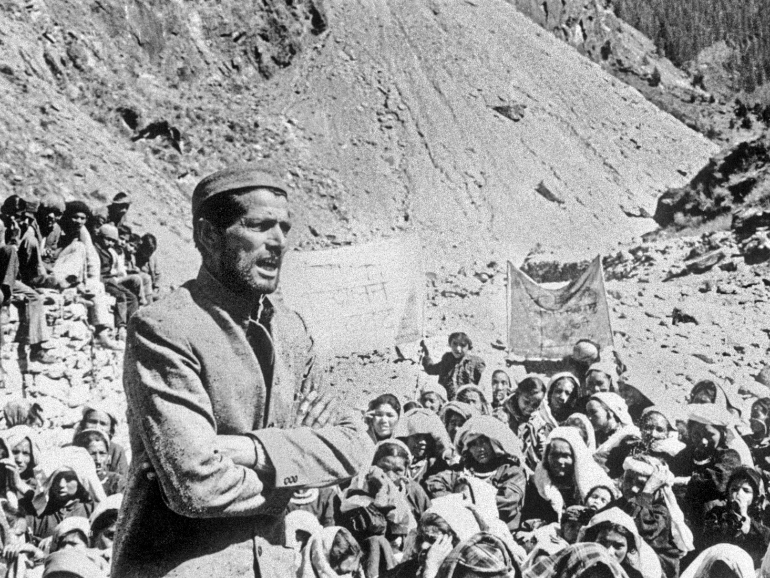
Actual picture of sunder lal bahuguna addressing the local peoples of uttrakhand during chipko movement.

Slide 7
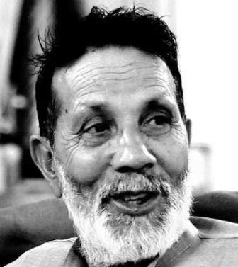
Chandi Prasad Bhatt
He is one of the founder of chipko movement ,an Environmentalist ,a Gandhian.
Padmabhushan and Gandhi peace prize winner.

Slide 8
“ Let them know we will not allow the felling of a single tree. When their men raise their axes, we will embrace the trees to protect them.”
- Chandi Prasad Bhatt

Slide 9
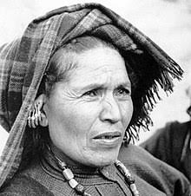
Gaura Devi
Known as Mother of Chipko Movement.
Head of the village Mahila Mangal Dal.
Mobilized village women for the movement when company men marched to cut the trees.

Slide 10
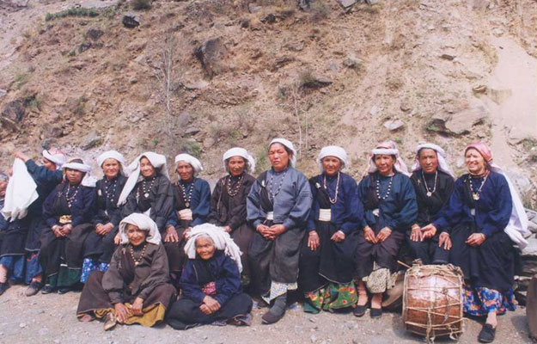
Gaura Devi’s words to the contractor’s men -
“The forest nurtures us like a mother, you will only be able to use your axes on it but you have to use them first on us.”

Slide 11
Success of Chipko Movement
It stopped felling of trees in the low land regions like Himalayas.
Generated pressure for formulation of a natural resource policy.
Achieved a major victory in 1980 with a 15-year ban on green felling in the Himalayan forests.
The movement has spread to many states in the country(H.P , M.P , Bihar, Karnatka(known as Appiko) ).
Afterward environmental awareness increased dramatically in India.
Peoples of local communities Started protecting forest slopes and Restoring bare ones.

Slide 12
It’s the first time when indian government formed policy for Forest protection.

Slide 13
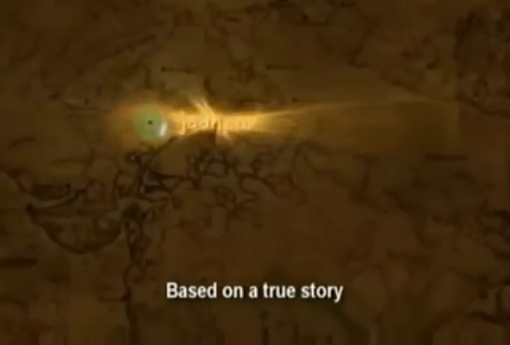
Notes:
Lesson descriptions should be brief.

Slide 14
SAVE TREES , PLANT TREES. Thank You

